Slide 1
Build your first app
Android Developer Fundamentals V2
Lesson 1

Slide 2
1.0 Introduction to Android

Slide 3

Contents
Android is an ecosystem
Android platform architecture
Android Versions
Challenges of Android app development
App fundamentals

Slide 4
Android Ecosystem

Slide 5
What is Android?
Mobile operating system based on Linux kernel
User Interface for touch screens
Used on over 80% of all smartphones
Powers devices such as watches, TVs, and cars
Over 2 Million Android apps in Google Play store
Highly customizable for devices / by vendors
Open source

Slide 6
Android user interaction
Touch gestures: swiping, tapping, pinching
Virtual keyboard for characters, numbers, and emoji
Support for Bluetooth, USB controllers and peripherals

Slide 7
Android and sensors
Sensors can discover user action and respond
Device contents rotate as needed
Walking adjusts position on map
Tilting steers a virtual car or controls a physical toy
Moving too fast disables game interactions

Slide 8
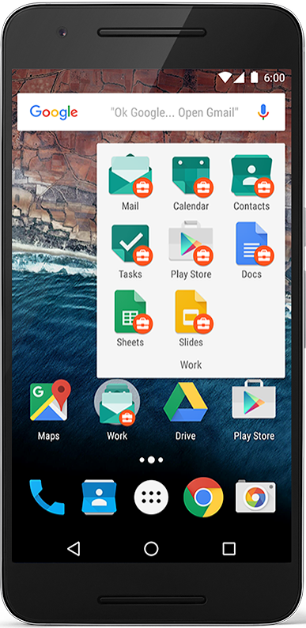
Android home screen
Launcher icons for apps
Self-updating widgets for live content
Can be multiple pages
Folders to organize apps
"OK Google"

Slide 9
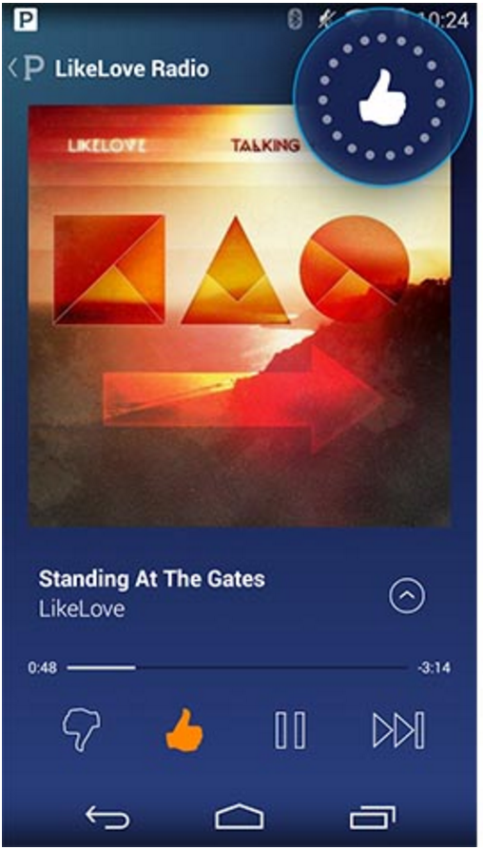
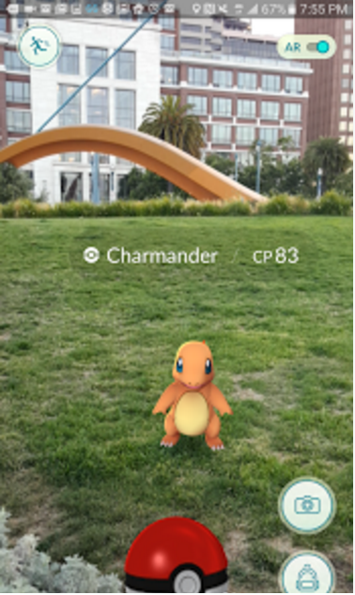
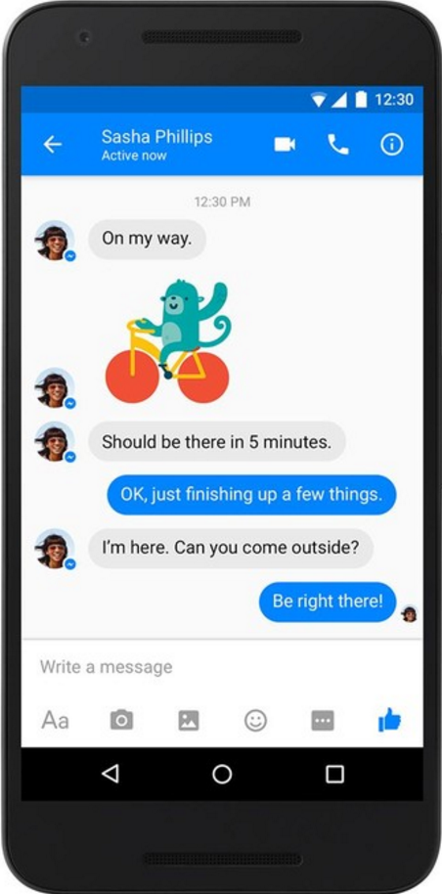
Android app examples
Pandora
Pokemon GO
Facebook Messenger

Slide 10
Android Software Developer Kit (SDK)
Development tools (debugger, monitors, editors)
Libraries (maps, wearables)
Virtual devices (emulators)
Documentation (developers.android.com)
Sample code

Slide 11
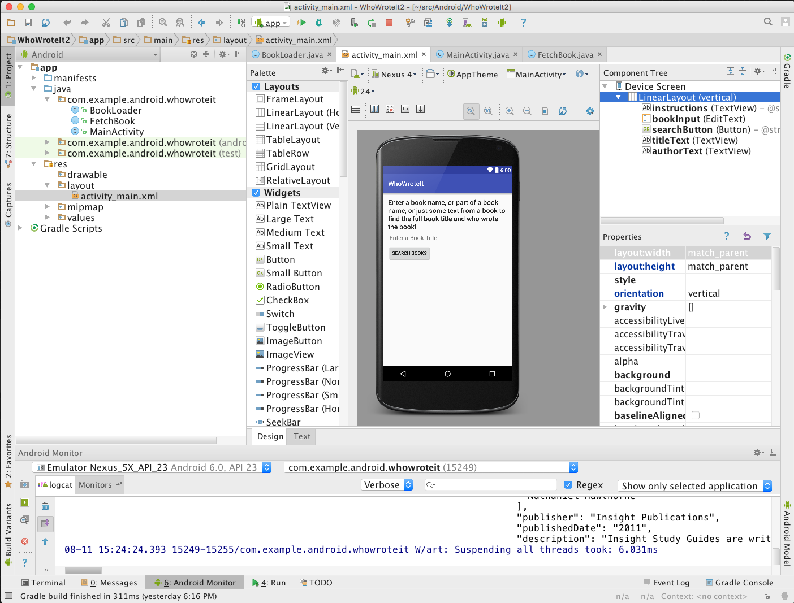
Android Studio
Official Android IDE
Develop, run, debug, test, and package apps
Monitors and performance tools
Virtual devices
Project views
Visual layout editor

Slide 12

Google Play store
Publish apps through Google Play store:
Official app store for Android
Digital distribution service operated by Google

Slide 13
Android Platform Architecture

Slide 14
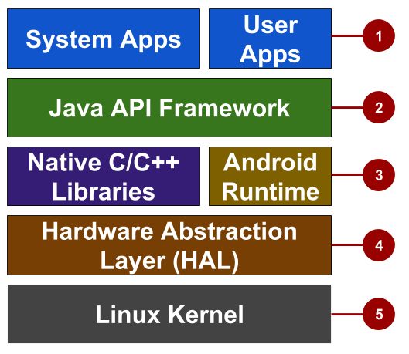


Android stack
Ứng dụng hệ thống + ứng dụng do nhà phát
triển tạo
System and user apps
Android OS API in Java framework
Expose native APIs; run apps
Expose device hardware capabilities
Linux Kernel
Thư viện java
Tạo các tính năng

Slide 15
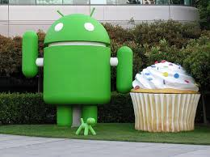
System and user apps
System apps have no special status
System apps provide key capabilities to app developers
Example:
Your app can use a system app to deliver a SMS message.
Ứng dụng hệ thống có thể được sử dụng bởi các ứng dụng khác
Ứng dụng gọi ứng dụng gửi tin nhắn của hệ thống để gửi sms

Slide 16
Java API Framework
The entire feature-set of the Android OS is available to you through APIs written in the Java language.
Cung cấp các hàm để tạo ra lớp giao diện , quản lý notification , quản lý activity
View class hierarchy to create UI screens
Notification manager
Activity manager for life cycles and navigation
Hiểu nôm na là 1 màn hình

Slide 17







Android runtime
Each app runs in its own process with its own instance of the Android Runtime.

Slide 18
C/C++ libraries
Core C/C++ Libraries give access to core native Android system components and services.

Slide 19


Hardware Abstraction Layer (HAL)
Standard interfaces that expose device hardware capabilities as libraries Examples: Camera, bluetooth module

Slide 20

Linux Kernel
Threading and low-level memory management
Security features
Drivers

Slide 21

Older Android versions
Codename | Version | Released | API Level
Honeycomb | 3.0 - 3.2.6 | Feb 2011 | 11 - 13
Ice Cream Sandwich | 4.0 - 4.0.4 | Oct 2011 | 14 - 15
Jelly Bean | 4.1 - 4.3.1 | July 2012 | 16 - 18
KitKat | 4.4 - 4.4.4 | Oct 2013 | 19 - 20
Lollipop | 5.0 - 5.1.1 | Nov 2014 | 21 - 22
Android History and Platform Versions
for more and earlier versions before 2011
Notes:
There were earlier versions before Feb 2011.

Slide 22
Newer Android versions
Codename | Version | Released | API Level
Marshmallow | 6.0 - 6.0.1 | Oct 2015 | 23
Nougat | 7.0 - 7.1 | Sept 2016 | 24 - 25
Oreo | 8.0 - 8.1 | Sept 2017 | 26 - 27
Pie | 9.0 | Aug 2018 | 28
Notes:
There were earlier versions before Feb 2011.

Slide 23
App Development

Slide 24


What is an Android app?
One or more interactive screens
Written using Java Programming Language and XML
Uses the Android Software Development Kit (SDK)
Uses Android libraries and Android Application Framework
Executed by Android Runtime Virtual machine (ART)

Slide 25
Challenges of Android development
Multiple screen sizes and resolutions
Performance: make your apps responsive and smooth
Security: keep source code and user data safe
Compatibility: run well on older platform versions
Marketing: understand the market and your users (Hint: It doesn't have to be expensive, but it can be.)

Slide 26
App building blocks
Resources: layouts, images, strings, colors as XML and media files
Components: activities, services, and helper classes as Java code
Manifest: information about app for the runtime
Build configuration: APK versions in Gradle config files

Slide 27
Learn more
Android History
Introduction to Android
Platform Architecture
UI Overview
Platform Versions
Supporting Different Platform Versions
Android Studio User’s Guide

Slide 28
What's Next?
Concept Chapter: 1.0 Introduction to Android
No Practical

Slide 29
END

